Slide 1
"We are strong when United"
Student 9 "A" class
MBOU SOSH Gorkovskiy
Polkovnikova Catherine

Slide 2
The enemy's jackals pace
To us the envious crawl.
Individuals not seen to be aggressive,
We will not tolerate the yoke.
Enough of us to count,
Alone shed tears.
The chaos of other people's empires
Will WE be able to stop.
We are strong when United,
We like a twig to break,
All the way can be overcome
Evil we can win!
Strengthen your spirit in unity,
Because the danger is great.
It's time to stop the excesses.
The world we wish for the ages!
So let us rather
Let us remove the burden of being
And get faster
From the jackals of the beast.
Maya Jan

Slide 3
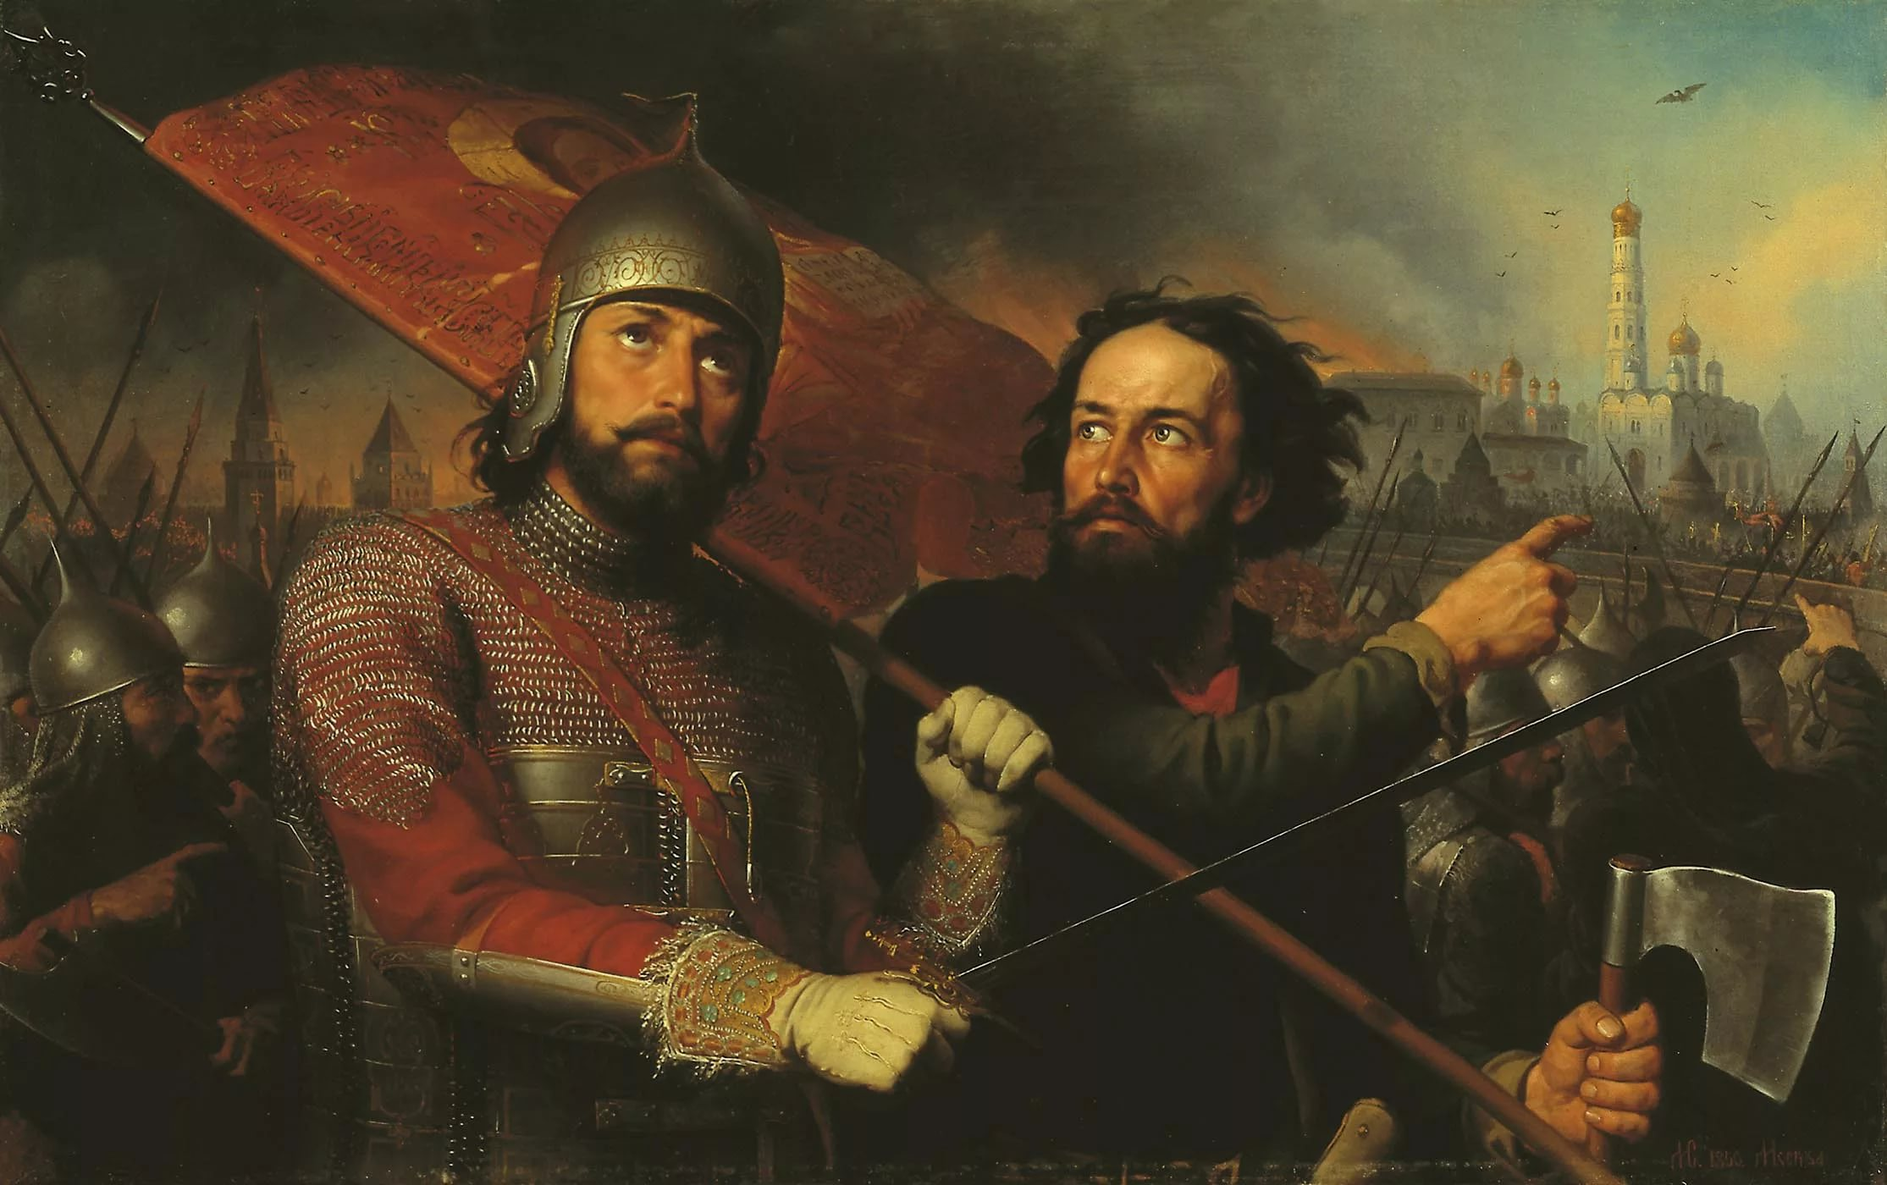
The Day of national unity is devoted to the events of the time of Troubles in 1612.

Slide 4
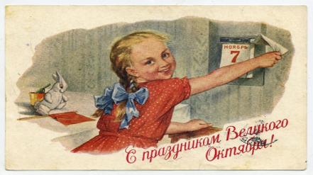
The 7th of November as the anniversary of the famous October revolution.

Slide 5
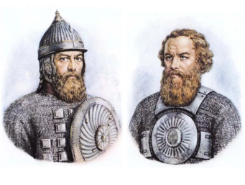
In 1612 our country was liberated from the Polish occupation with the help of Kuzma Minin , the Governor of Nizhny Novgorod, and Prince Dmitry Pozharsky.

Slide 6
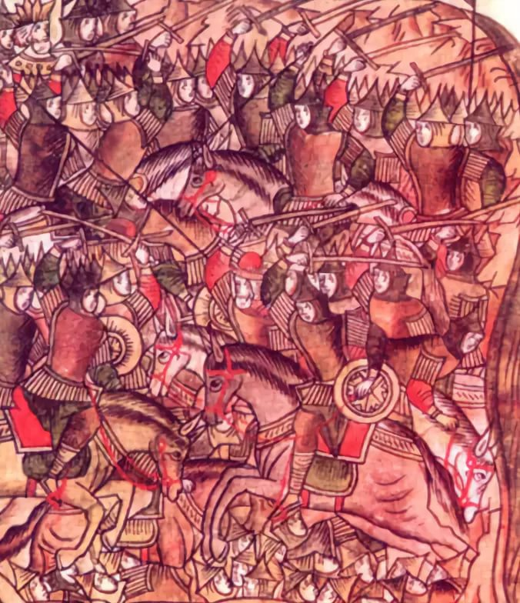
The people's emergency volunteer corps

Slide 7
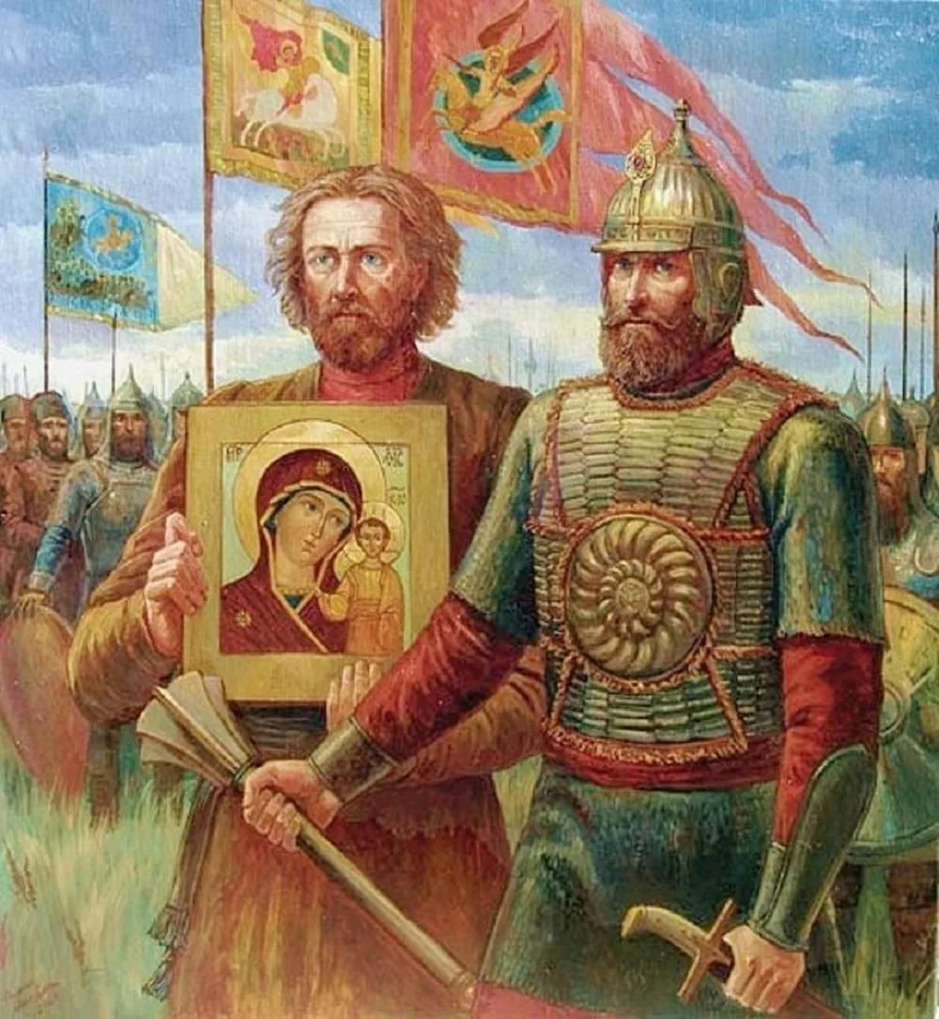
Pozharsky was carrying the Kazan icon of the mother of God

Slide 8
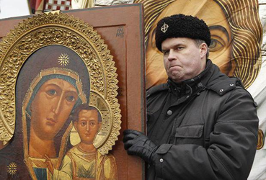
In honor of this event on red square in 1612 he built the Kazan Cathedral. It was destroyed during the persecution of the Church, now restored.

Slide 9
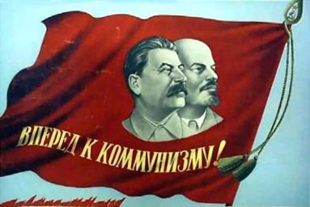
The 7th of November was announced as the day of revolution and the celebration of the 4th of November was canceled

Slide 10
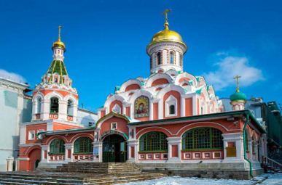
Some people believe that it is not well to break the old tradition, shifting the focus from one event to another, the second (including many Orthodox), on the contrary, believe that this day is the revival of history.

Slide 11
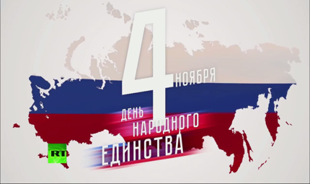
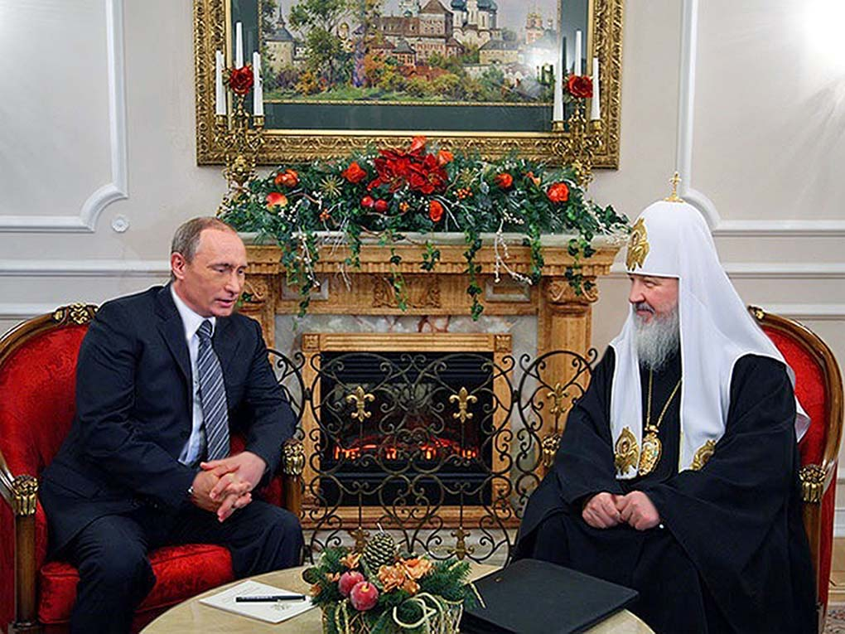
In 2004 the 4th of November was declared as the day of national unity

Slide 12
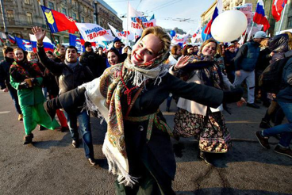
People need to be kinder to each other, as the roots of generations is closely intertwined among themselves.

Slide 13
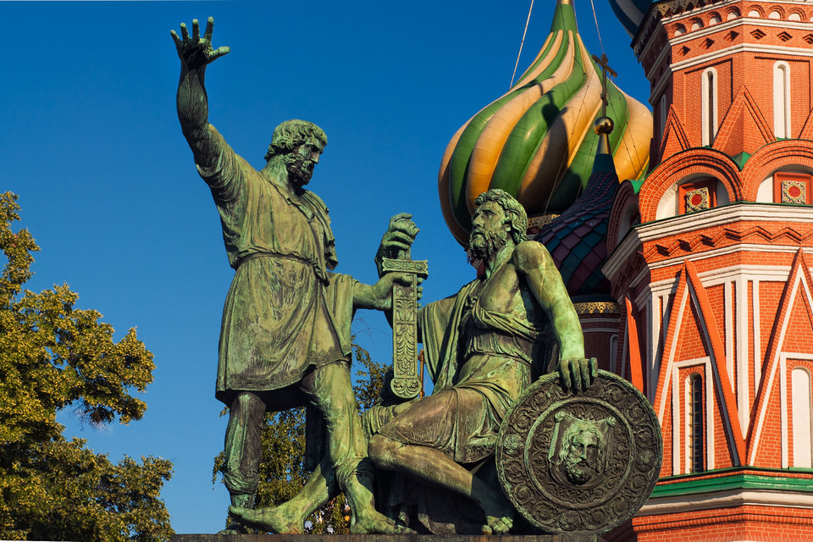

Slide 14
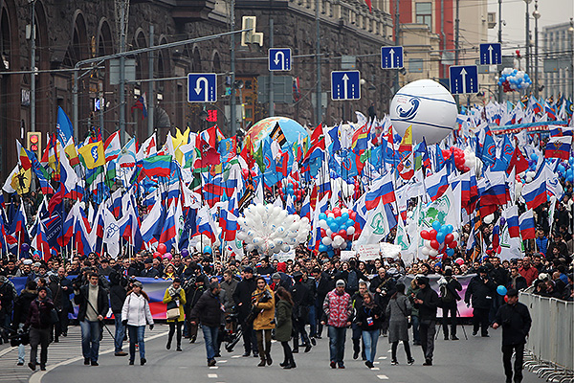
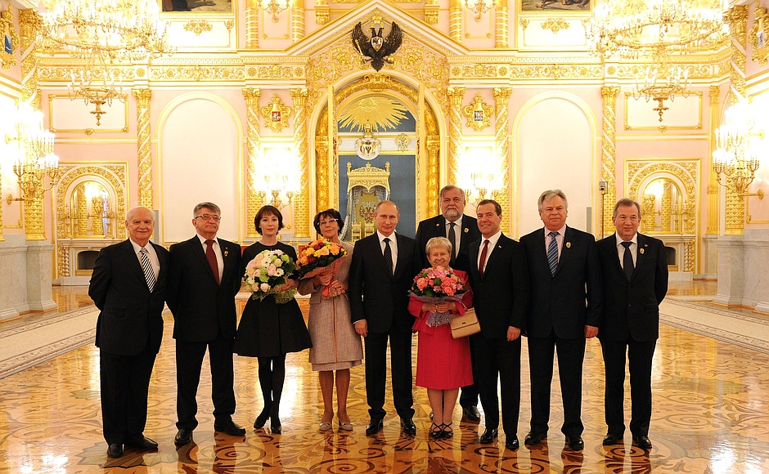

Slide 15
Thank you for your attention!

